Slide 1

Airbnb Listings Dashboard
By Swapna Macha

Slide 2
Contents
Project Brief
Dataset Overview
Problems or challenges in the Dataset
Data Cleaning and Transformation Process
Insights and Findings
Recommendations

Slide 3
Project Brief
Aims to optimize pricing strategies, improve property performance, and enhance customer satisfaction.
Analyzes data across dimensions like property type, location, pricing, and reviews.
Provides actionable recommendations for hosts and stakeholders to boost revenue and performance.
Utilizes Excel ,Tableau for data cleaning and creating interactive visualizations.
Highlights customer preferences, revenue trends, and high-performing neighborhoods.
The Airbnb Listings Analysis project focuses on extracting insights from Airbnb listings data.

Slide 4
Dataset Overview
The dataset contains information on Airbnb listings, including:
Property Details: Type, size, and amenities.
Pricing Data: Nightly rates and revenue potential.
Location Metrics: Neighborhood and geographic clustering.
Customer Reviews: Ratings, review count, and guest feedback.
Availability Metrics: Number of available days per year.

Slide 5
Problems or Challenges in the Dataset
Missing Data: Incomplete fields like price and availability.
Outliers: Extreme values in pricing and occupancy rates skewed the analysis.
Inconsistent Formats: Non-standardized formats for key metrics such as price and availability.
Data Volume: Large dataset required aggregation for meaningful visualization

Slide 6
Data Cleaning Transformation Process
Removed duplicates and irrelevant records.
Handled missing data through interpolation or exclusions.
Standardized formats for fields like price and availability.
Created calculated fields for metrics like revenue potential and occupancy rates.

Slide 7
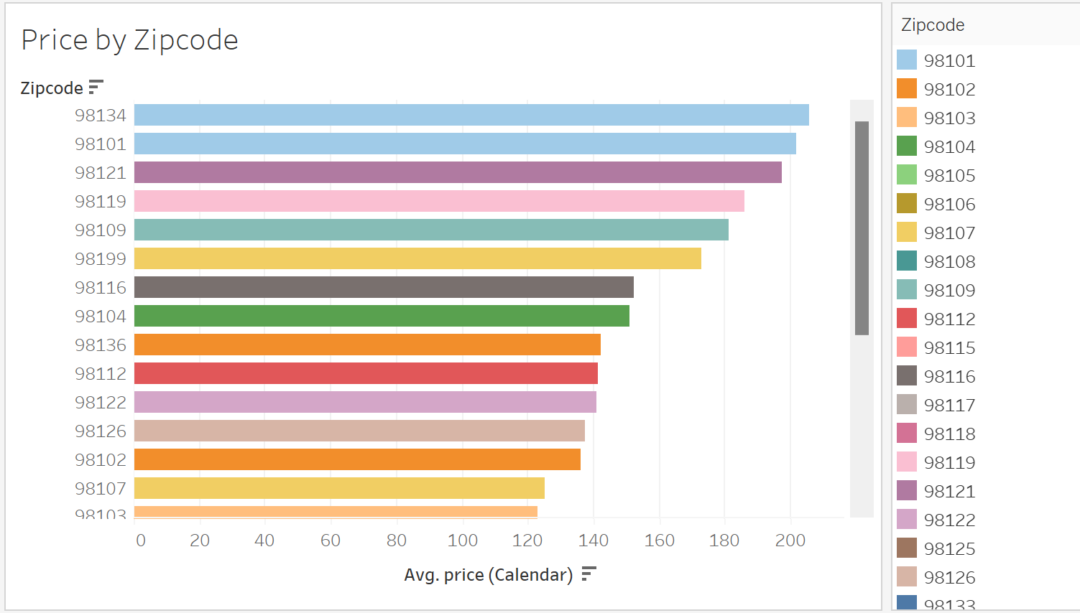
Zipcode 98134 has the highest average price, indicating premium listings.
Zipcode 98125 has the lowest average price, suggesting more affordable options.
Significant price variations exist across zip codes, highlighting location as a key factor in pricing.

Slide 8
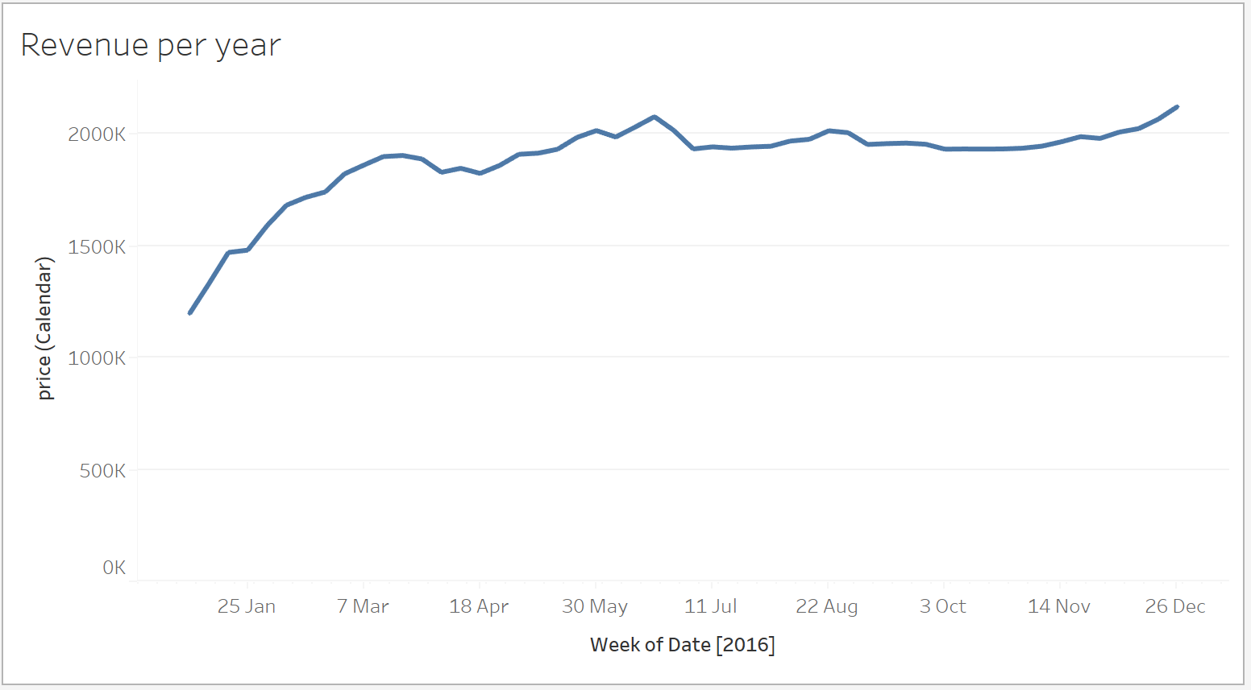
Revenue steadily increases throughout the year, peaking in mid-July.
A slight dip in revenue occurs in the late summer and early autumn months.
Revenue starts to rise again in December, indicating higher demand during the holiday season.
Seasonal trends suggest that summer and the end-of-year holidays are optimal times for revenue generation.

Slide 9
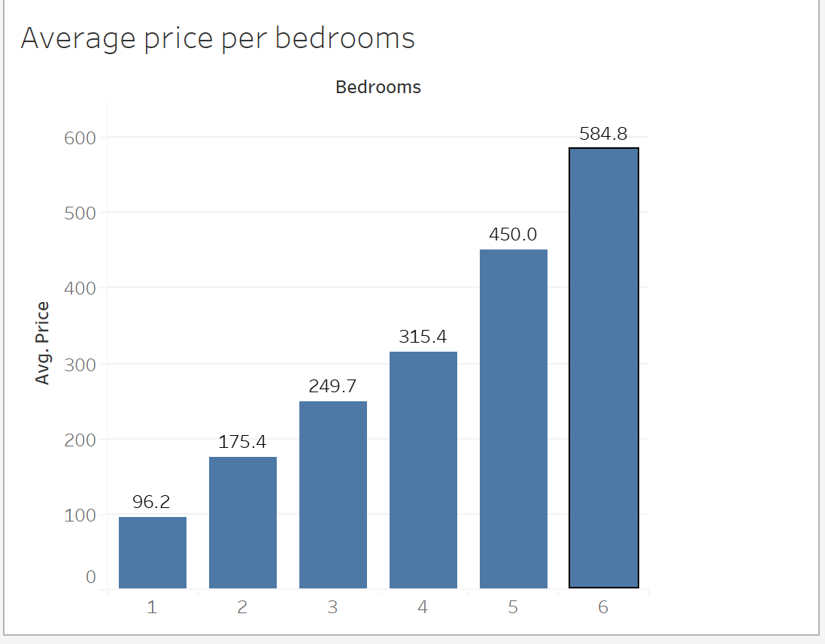
The average price increases with the number of bedrooms, peaking at $584.8 for 6-bedroom listings, indicating a strong correlation between property size and pricing.

Slide 10
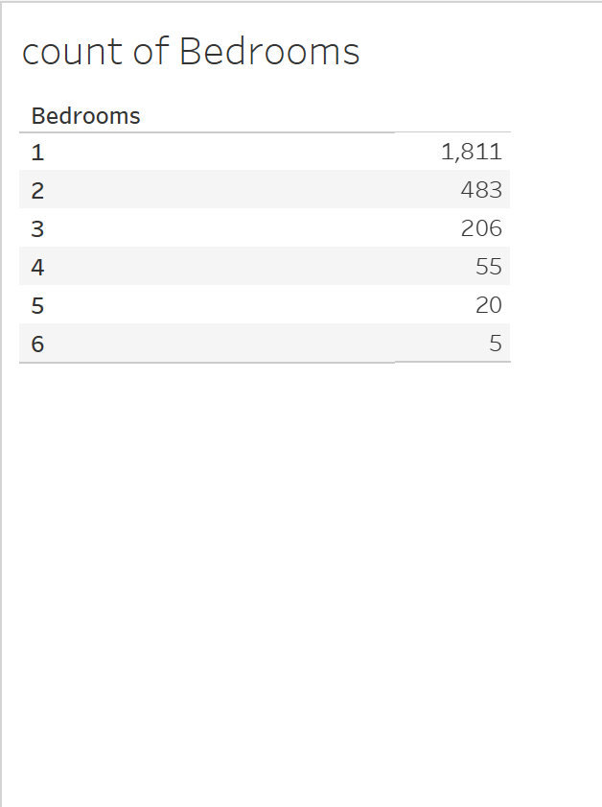
Listings with 1 bedroom dominate the market with 1,811 entries, indicating a preference for smaller properties.
2-bedroom listings are the second most common, with 483 entries.
Properties with 3 or more bedrooms are significantly less frequent, with only 5 listings having 6 bedrooms, highlighting their rarity.

Slide 11
Recommendations
Optimize Pricing Strategies: Adjust pricing based on neighborhood demand and seasonal trends.
Focus on High-Performing Locations: Prioritize listings in high-demand neighborhoods.
Enhance Property Offerings: Invest in amenities to boost occupancy and customer satisfaction.
Use Data for Decision-Making: Regularly monitor dashboard insights for strategy adjustments.

Slide 12

Thank you

